Slide 1

Smart Traffic Navigator
SREYAS INSTITUTE OF ENGINEERING & TECHNOLOGY
(AUTONOMUS)
(Approved by A.I.C.T.E.,New Delhi., Affiliated to JNTUH Hyderabad, Accredited by NAAC ‘A’ Grade & NBA)
DEPARTMENT OF COMPUTER SCIENCE ENGINEERING(AI&ML)
Group – 14
Team Members:
Md.Shabana Afsa - 23VE1A6630
T.Aishwarya - 23VE1A6647
K.Srinidhi - 23VE1A6622
T.Siri Meghana - 23VE1A6652
A.Nikitha - 23VE1A6603
G.Ashwitha - 23VE1A6613
Y.Devisri Santhoshi - 23VE1A6664

Slide 2
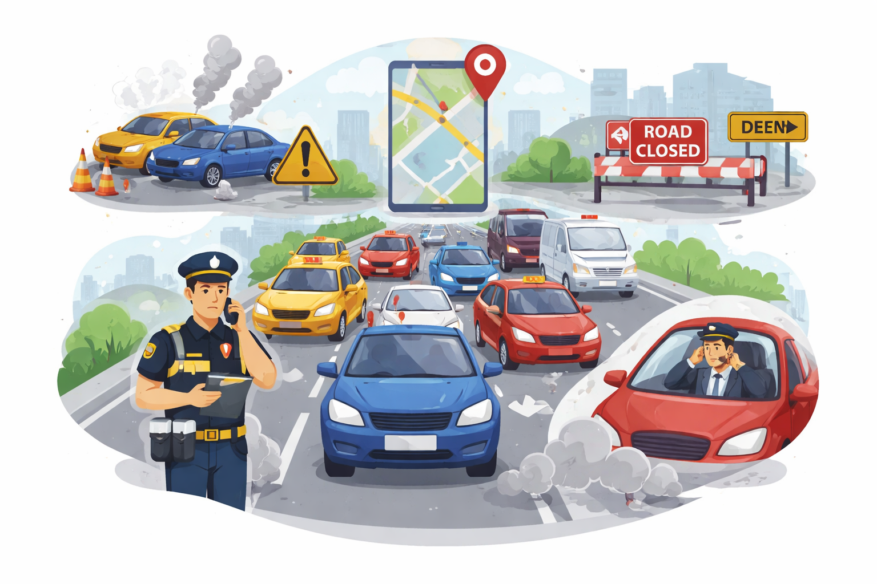
Problem Statement:
Smart Traffic Navigator – Citizen-Driven Traffic Monitoring & Route Guidance System Urban areas face frequent traffic congestion due to accidents, road blockages, and poor traffic monitoring.

Slide 3
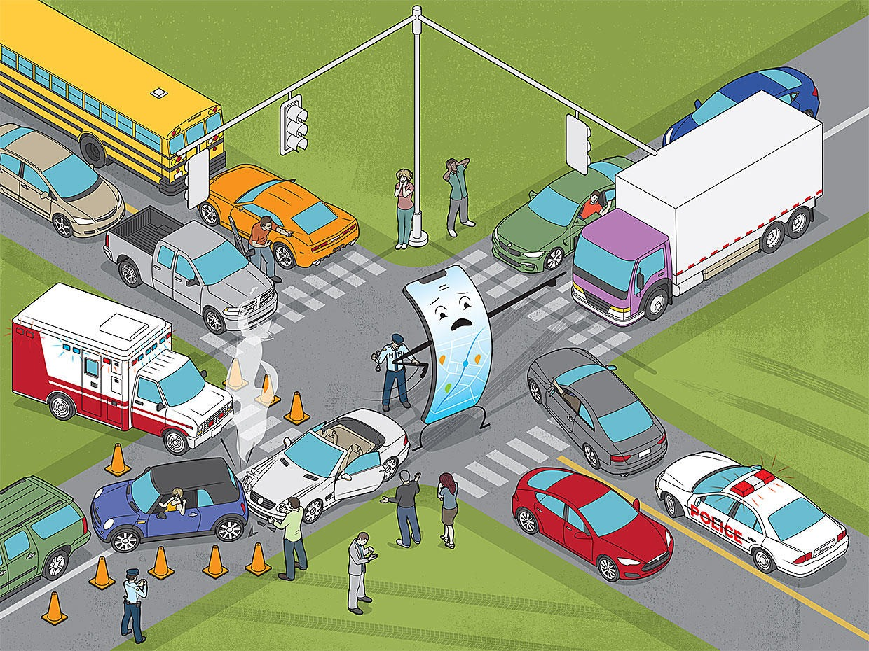
Introduction
Smooth and safe transportation is essential for daily life in modern cities. However, increasing traffic congestion, accidents, and road blockages often cause delays and inconvenience to commuters. Many traffic issues are not reported in real time, making it difficult for authorities to manage traffic efficiently.
The Smart Traffic Navigator is a citizen-driven web platform that allows users to report traffic problems, view traffic density, and receive alternative route suggestions, while helping authorities improve traffic management through real-time data.

Slide 4
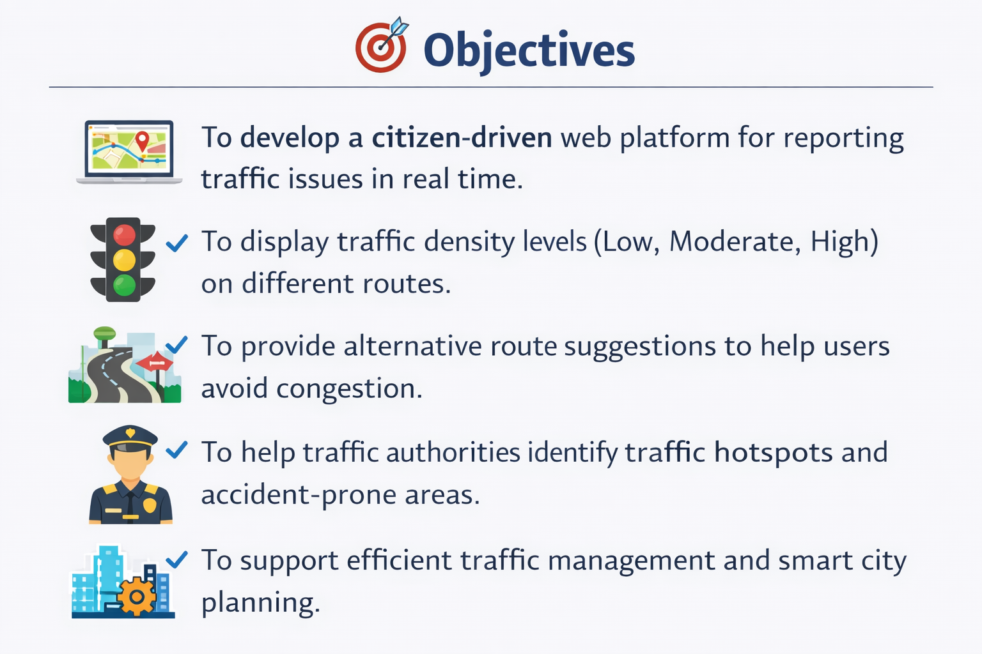
Objectives:
To develop a citizen-driven web platform for reporting traffic issues in real time.
To display traffic density levels (Low, Moderate, High) on different routes.
To provide alternative route suggestions to help users avoid congestion.
To help traffic authorities identify traffic hotspots and accident-prone areas.
To support efficient traffic management and smart city planning.

Slide 5
System Architecture:
1.Route Selection
Users select Source and Destination
The system displays available routes on an interactive map
2.Traffic Issue Reporting
Citizens can report:
Heavy congestion
Road blockages
Accident-prone zones
Along with:
Map-based location selection
Traffic reason
Optional image upload for better clarity
3.Traffic Density Visualization
Each route is color-coded to show traffic levels:
🟢 Low Traffic
🟡 Moderate Traffic
🔴 High Traffic

Slide 6
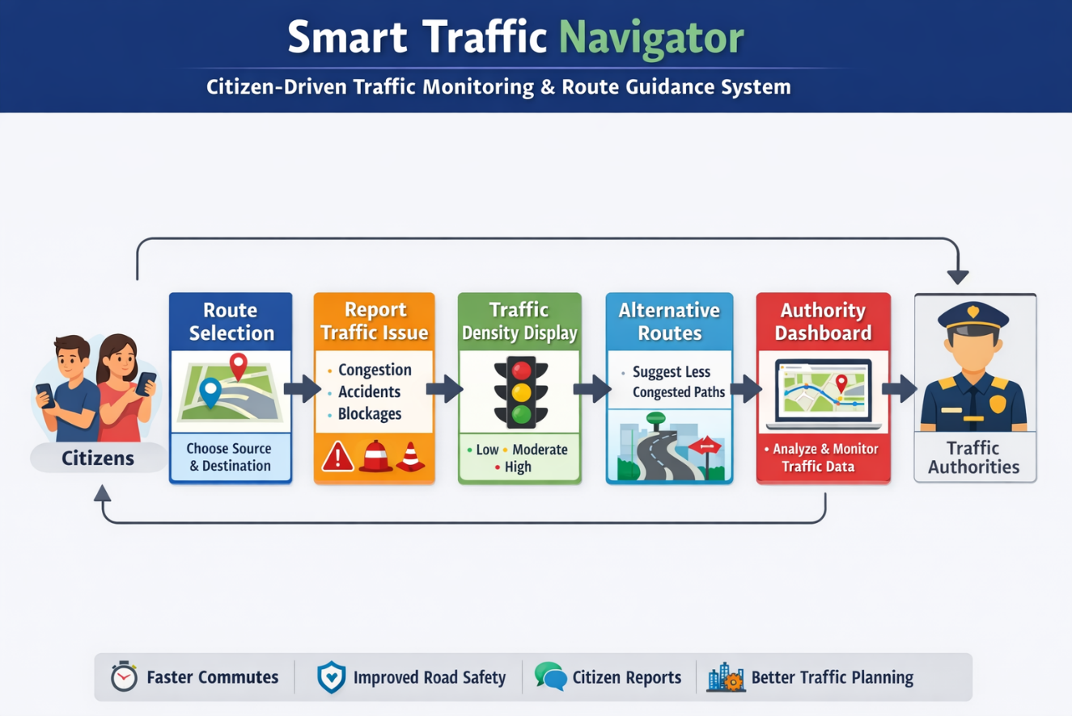
4.Alternative Route Suggestions
The system recommends less congested routes
Helps users avoid delays and plan faster journeys
5.Authority Dashboard
Traffic officials can:
Monitor real-time traffic hotspots
Analyze frequently congested locations
Identify accident-prone areas
Use collected data for better urban traffic planning

Slide 7
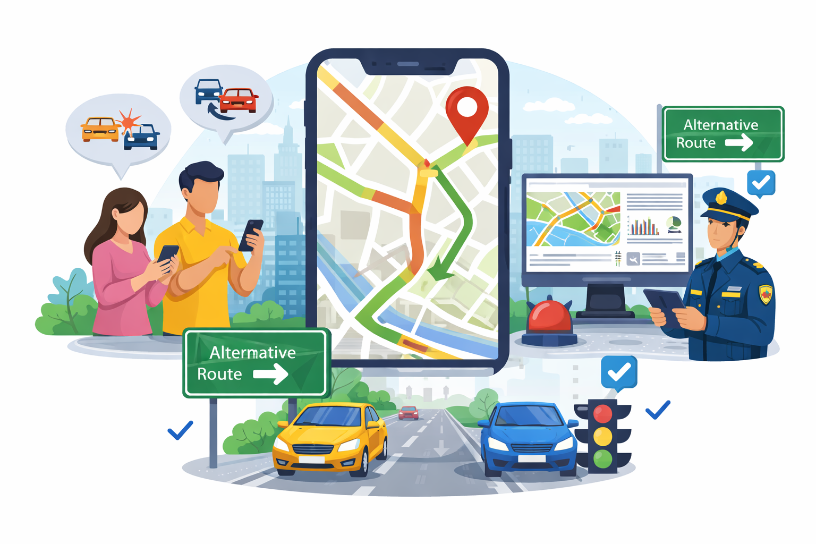
Solution
The Smart Traffic Navigator provides real-time traffic updates based on citizen reports.
Users can view traffic density on routes and receive alternative route suggestions to avoid congestion.
Traffic authorities can monitor reported issues, identify hotspots, and take timely action for better traffic management.

Slide 8
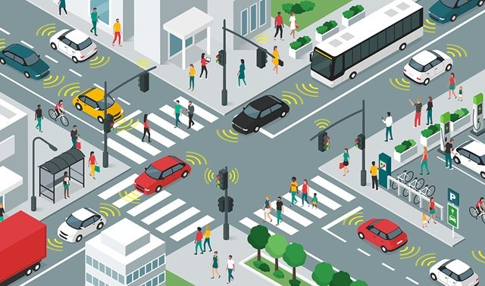
Advantages
Reduces travel time by suggesting less congested routes
Saves fuel and lowers transportation costs
Improves road safety and emergency response
Enables active citizen participation in traffic reporting
Helps authorities make data-driven traffic decisions
Supports smart city and intelligent transportation systems

Slide 9
Conclusion
The Smart Traffic Navigator provides an effective solution to manage urban traffic through citizen participation and real-time reporting. By displaying traffic density and suggesting alternative routes, it helps reduce travel delays and improve road safety. The system also supports traffic authorities with valuable data, contributing to smarter and more efficient traffic management.

Slide 10


